Slide 1
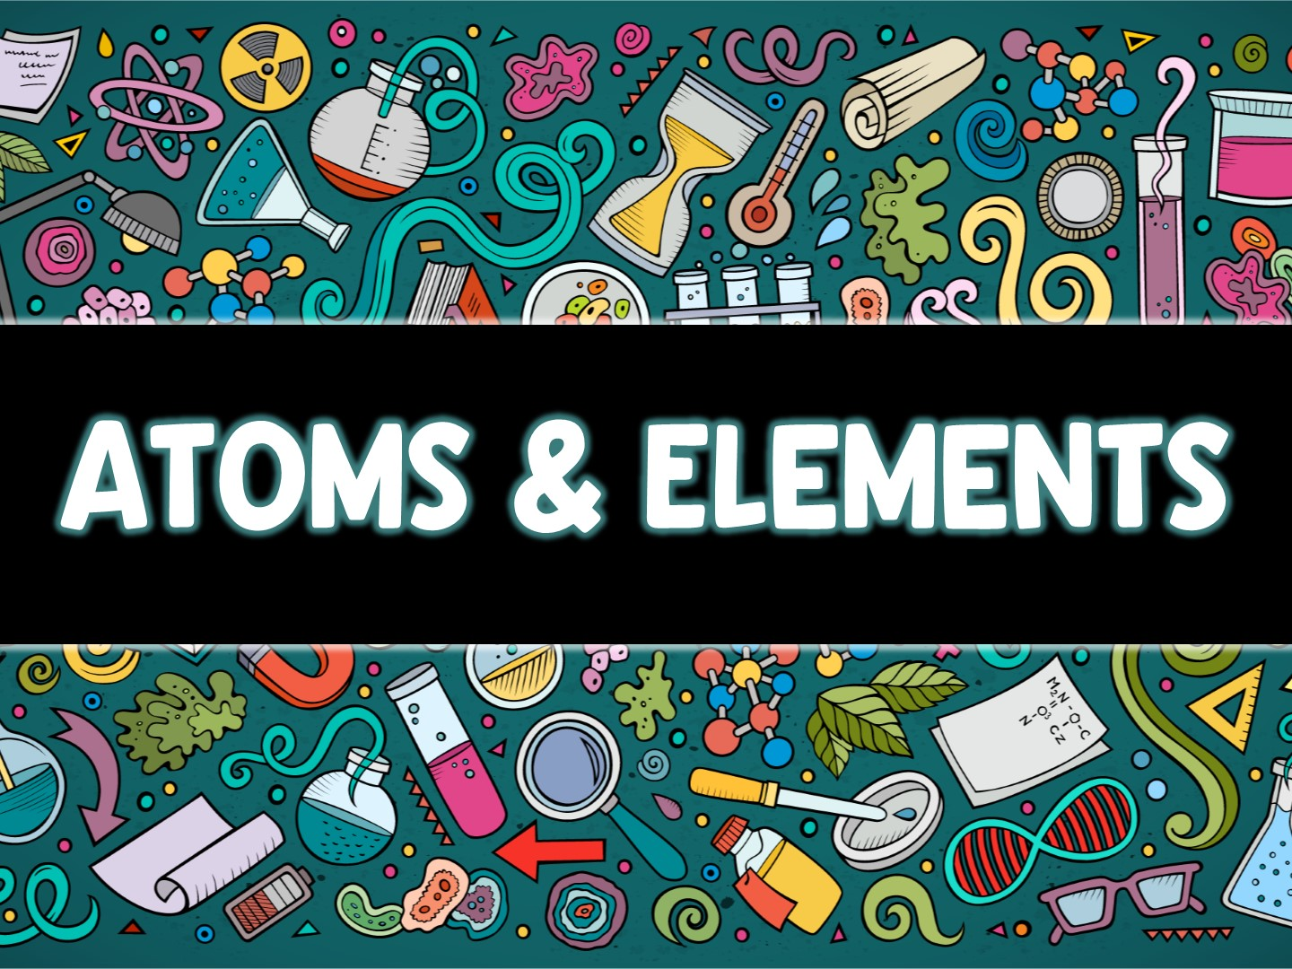

Slide 2
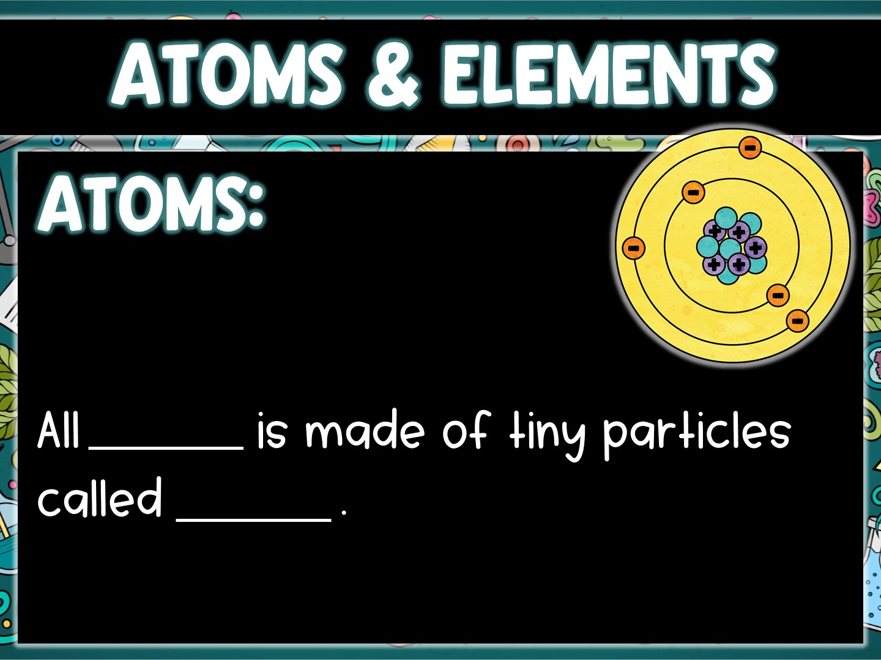
matter
atoms

Slide 3
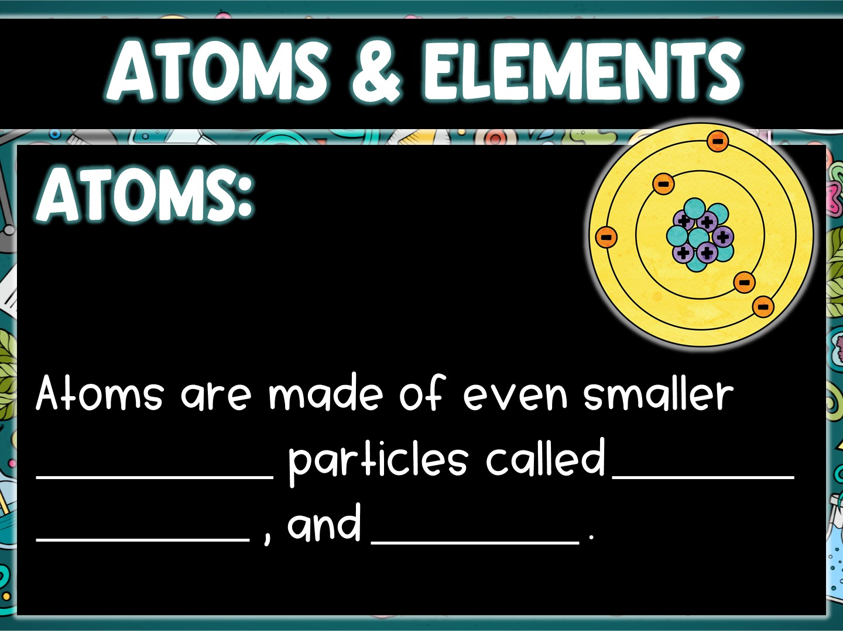
subatomic
protons
electrons
neutrons

Slide 4
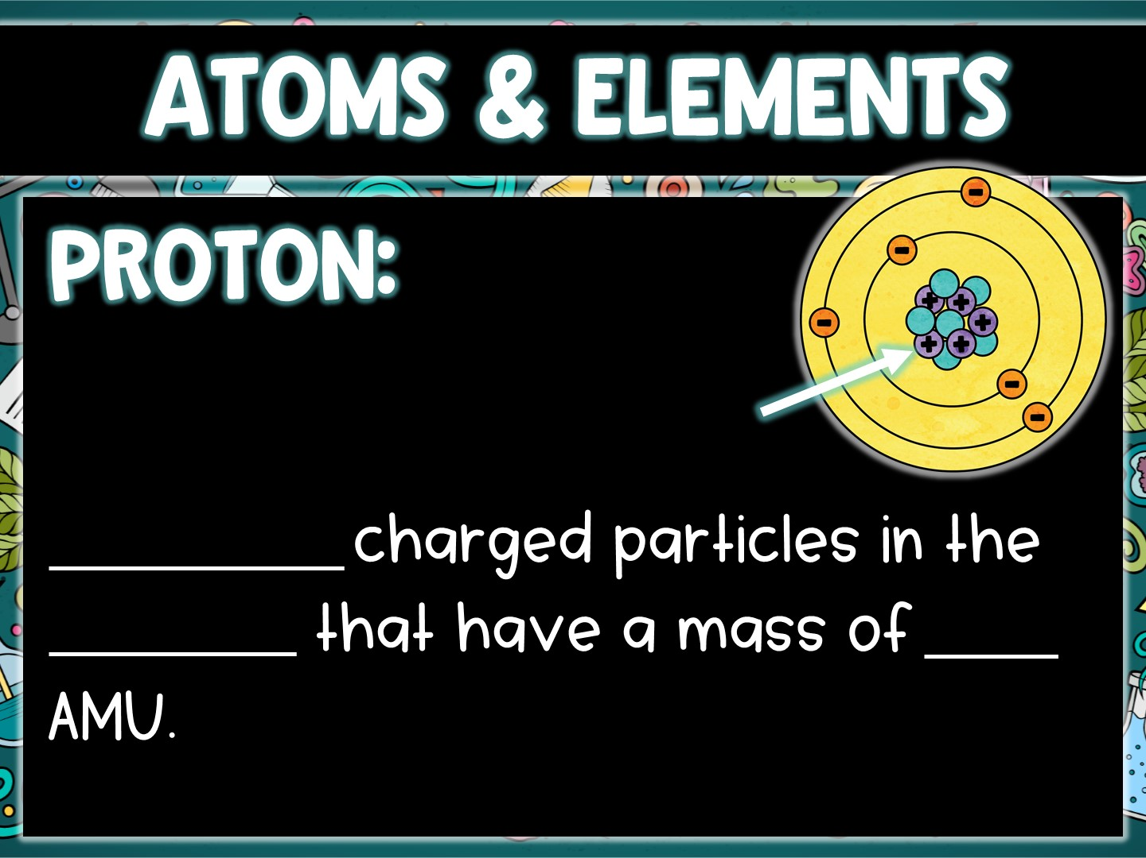
Positively
nucleus
one

Slide 5
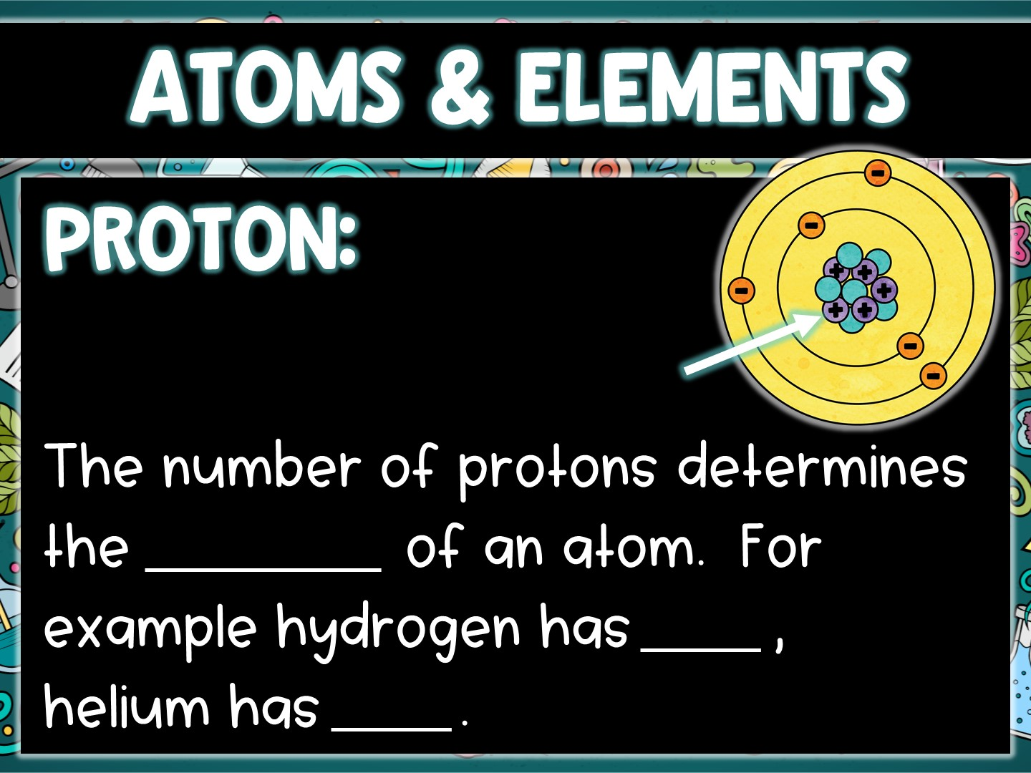
element
one
two

Slide 6
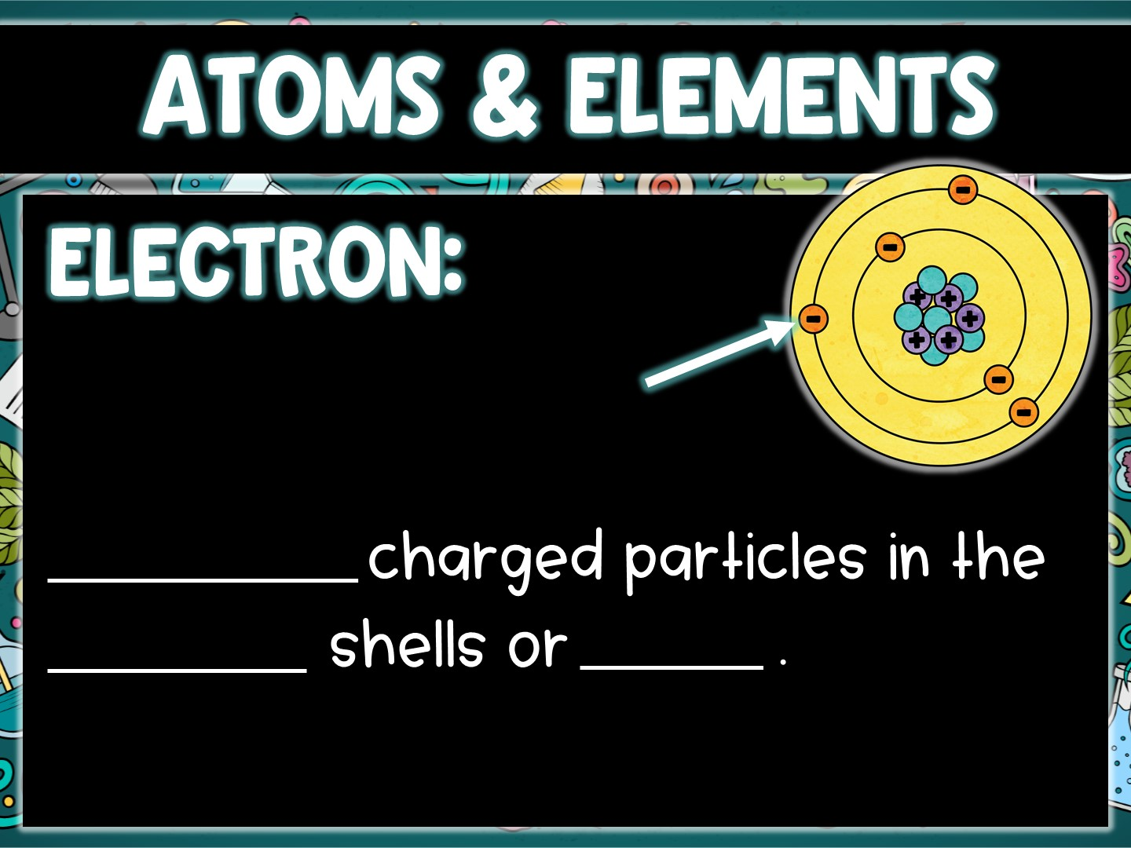
Negatively
electron
levels

Slide 7
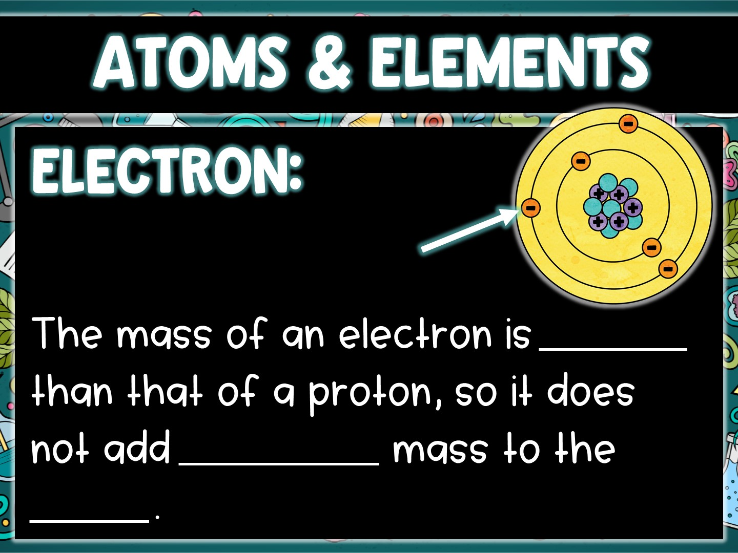
1/1850
significant
atom

Slide 8
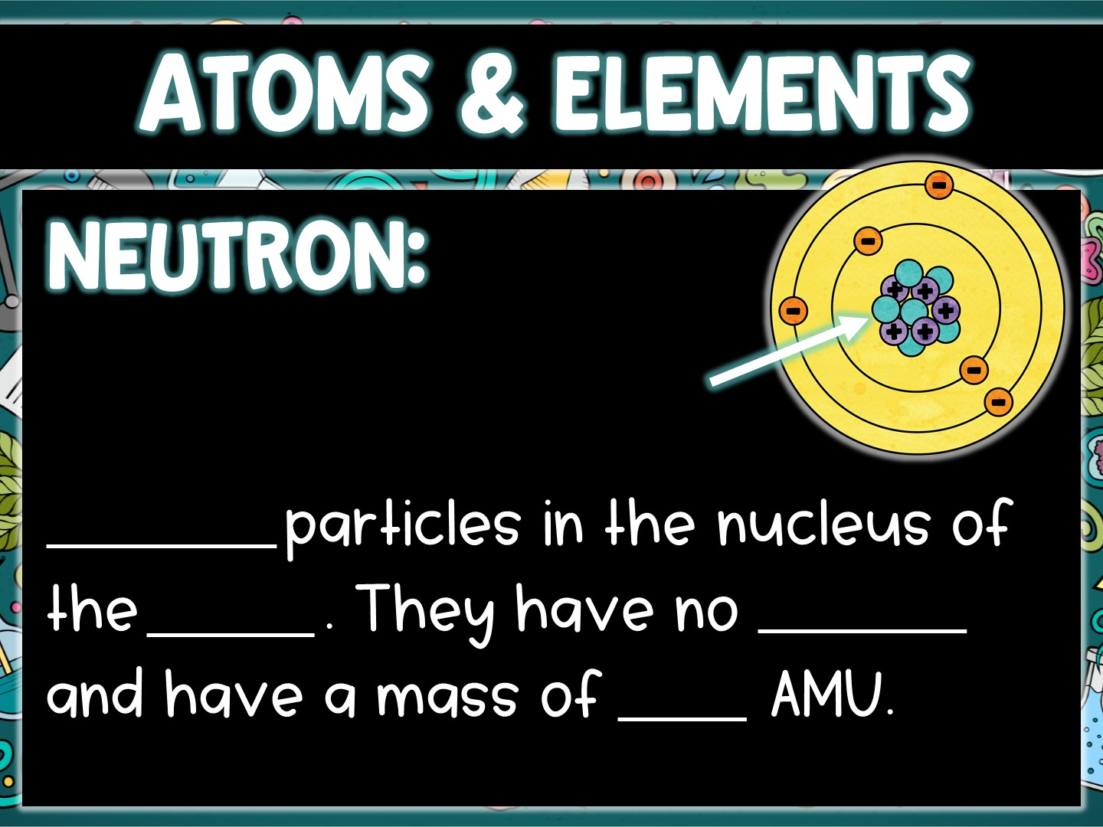
Neutral
atom
charge
one

Slide 9
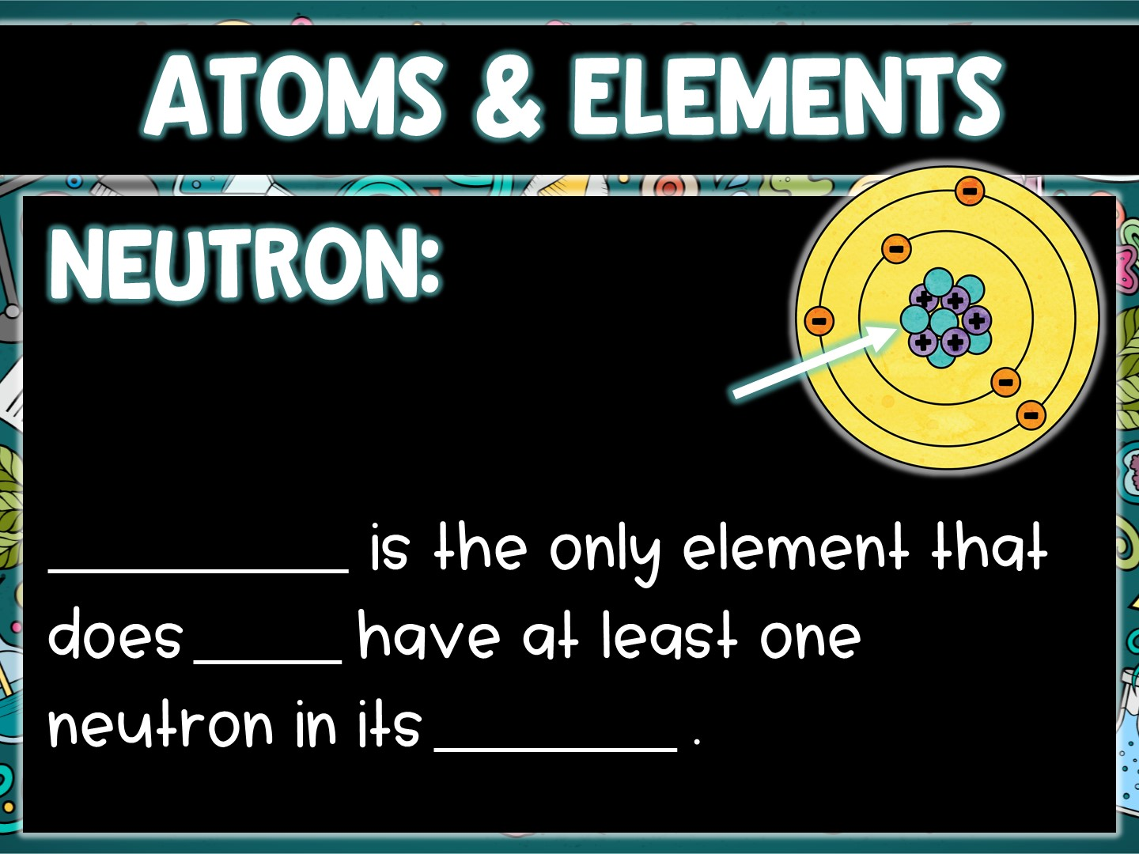
Hydrogen
NOT
nucleus

Slide 10
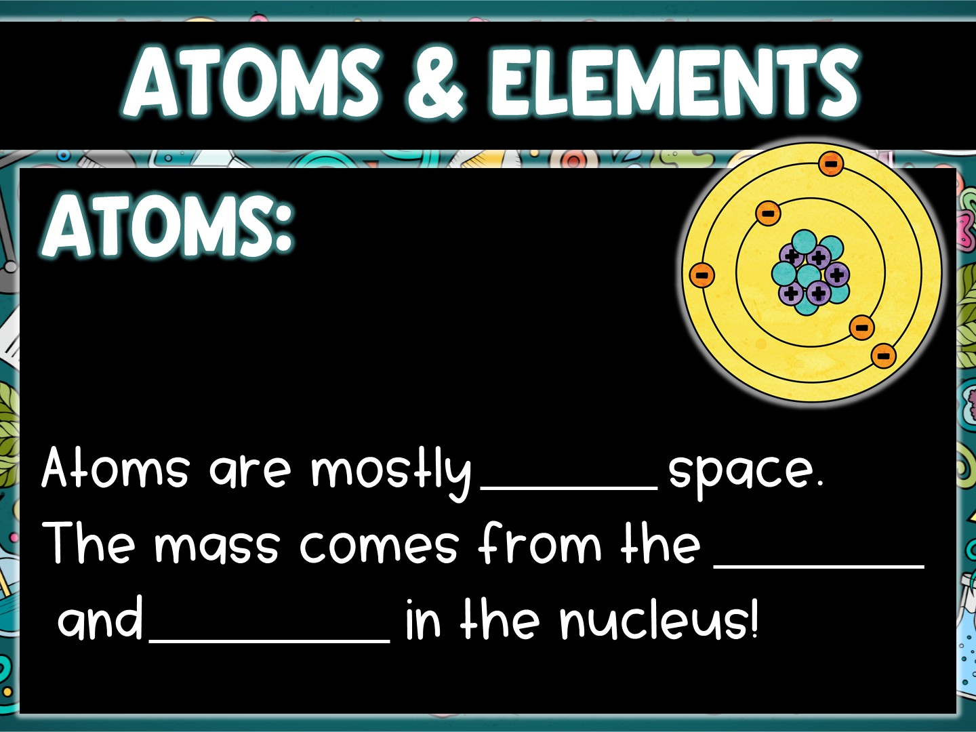
empty
protons
neutrons

Slide 11
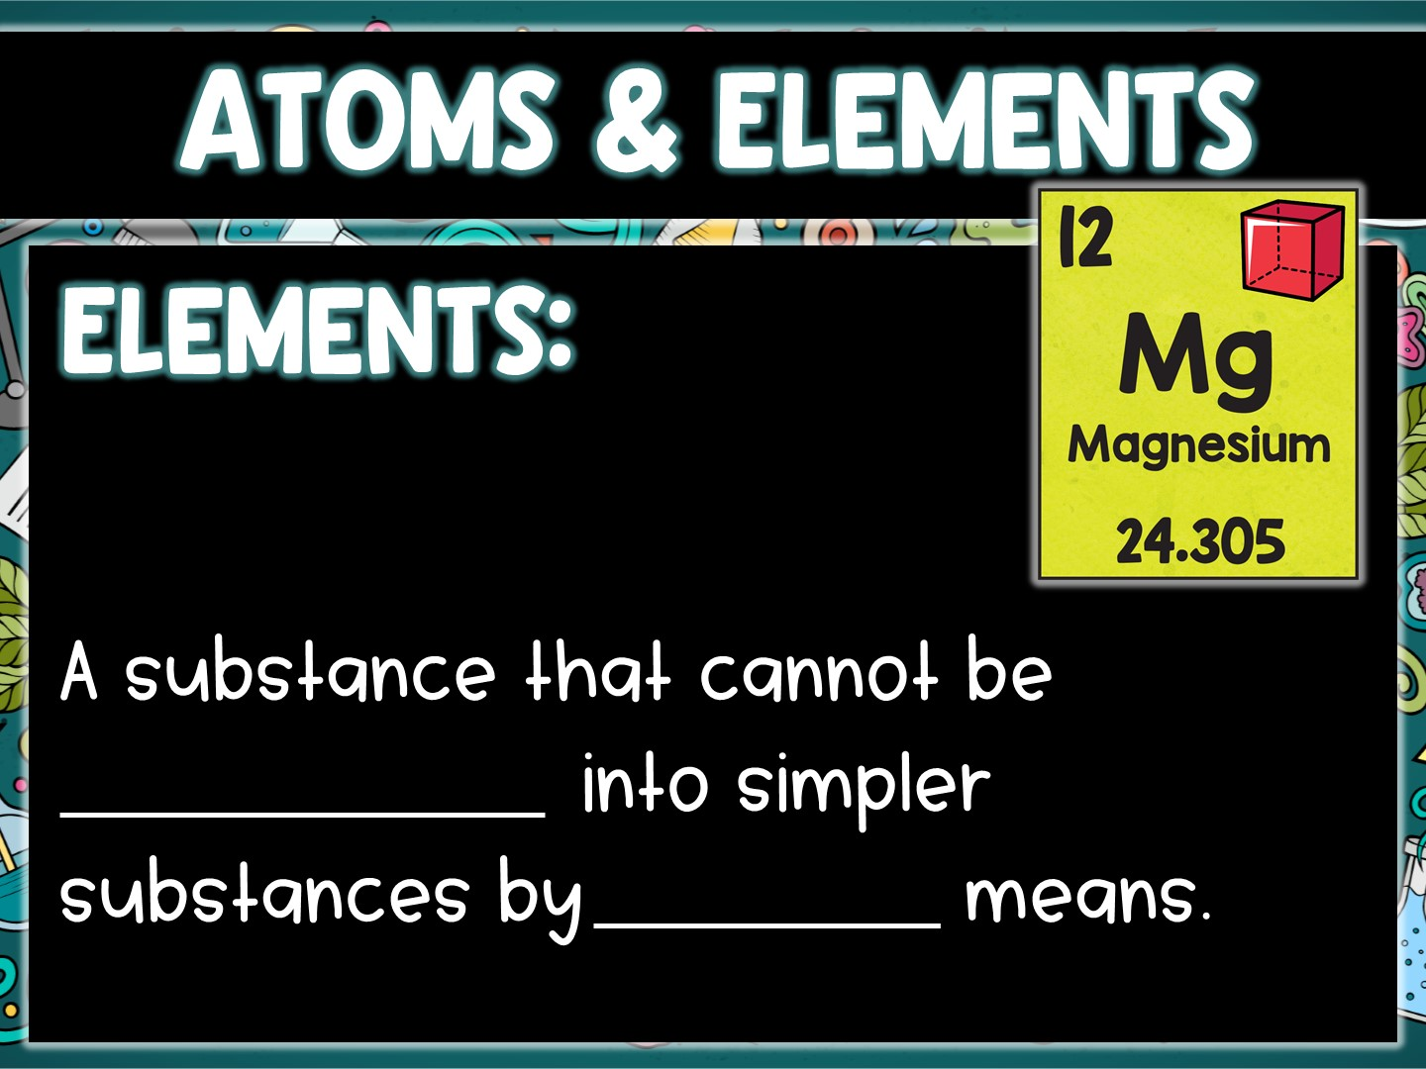
broken down
chemical

Slide 12
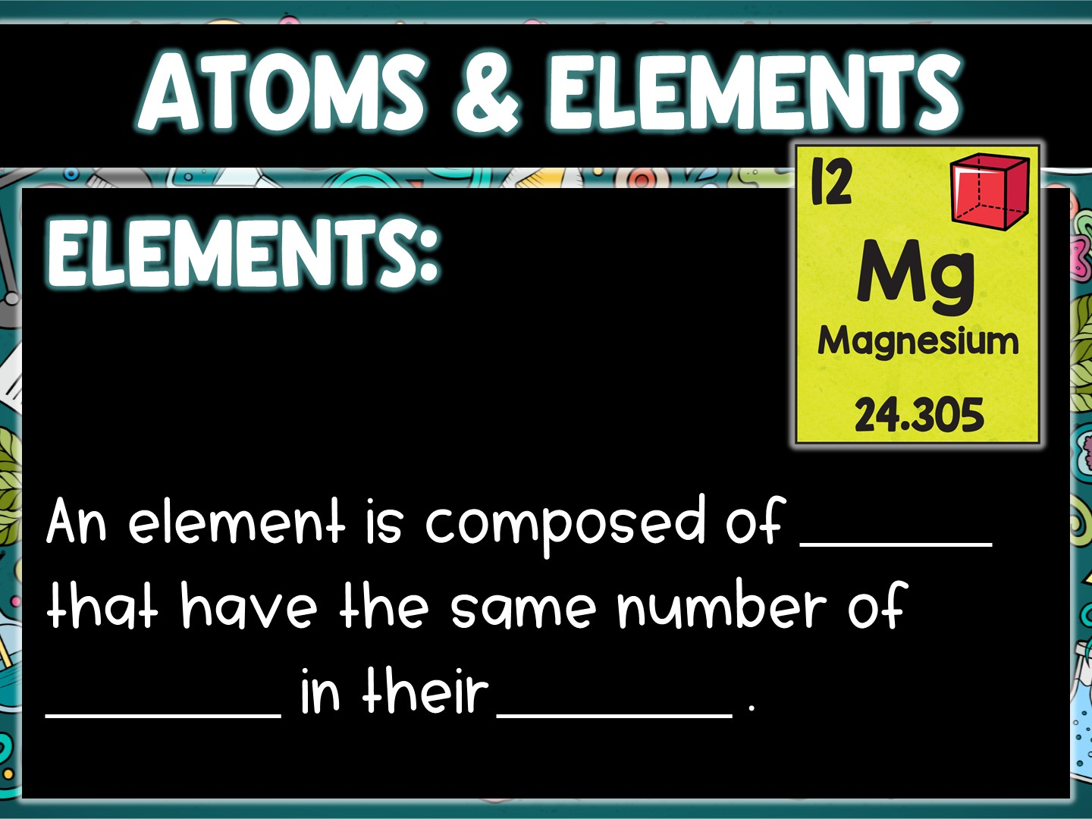
atoms
protons
nucleus

Slide 13
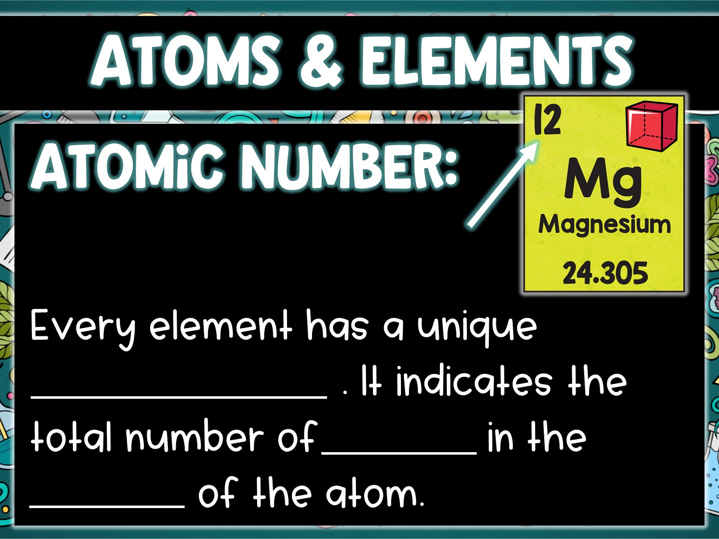
Atomic Number
protons
nucleus

Slide 14
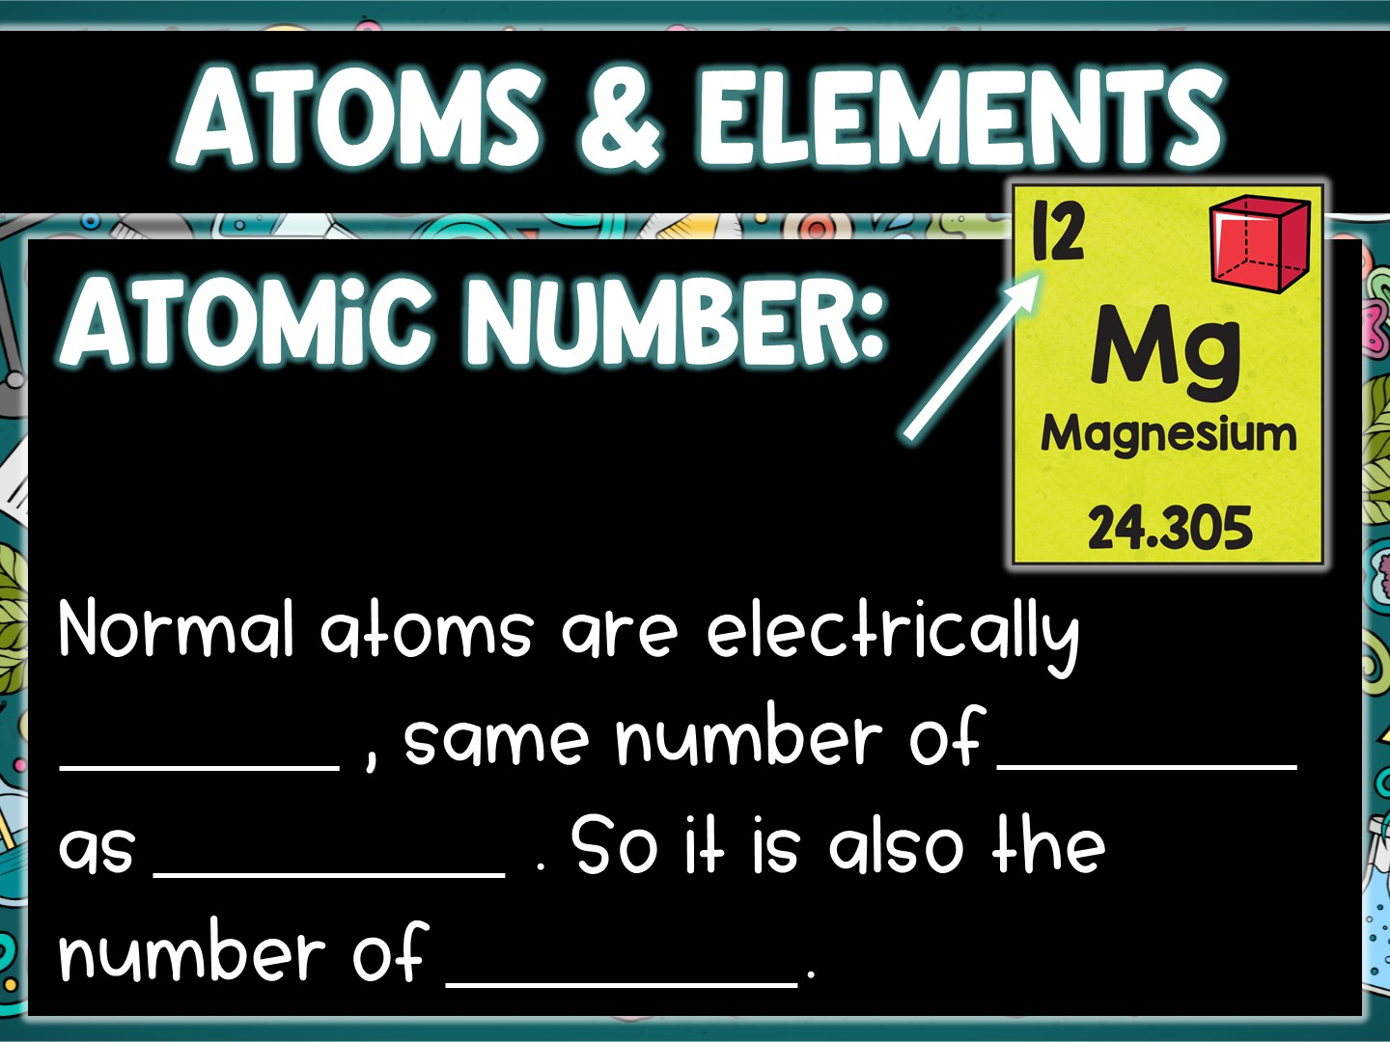
neutral
protons
electrons
electrons

Slide 15
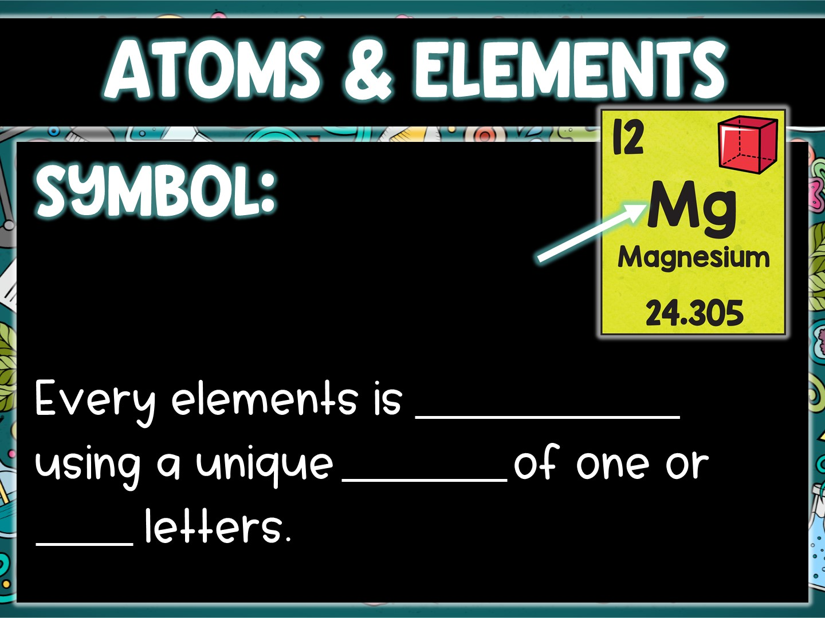
abbreviated
symbol
two

Slide 16
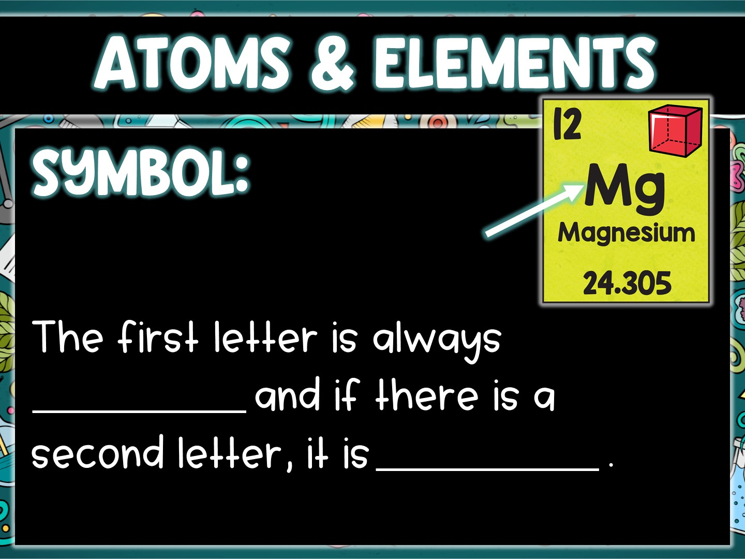
capitalized
lower case

Slide 17
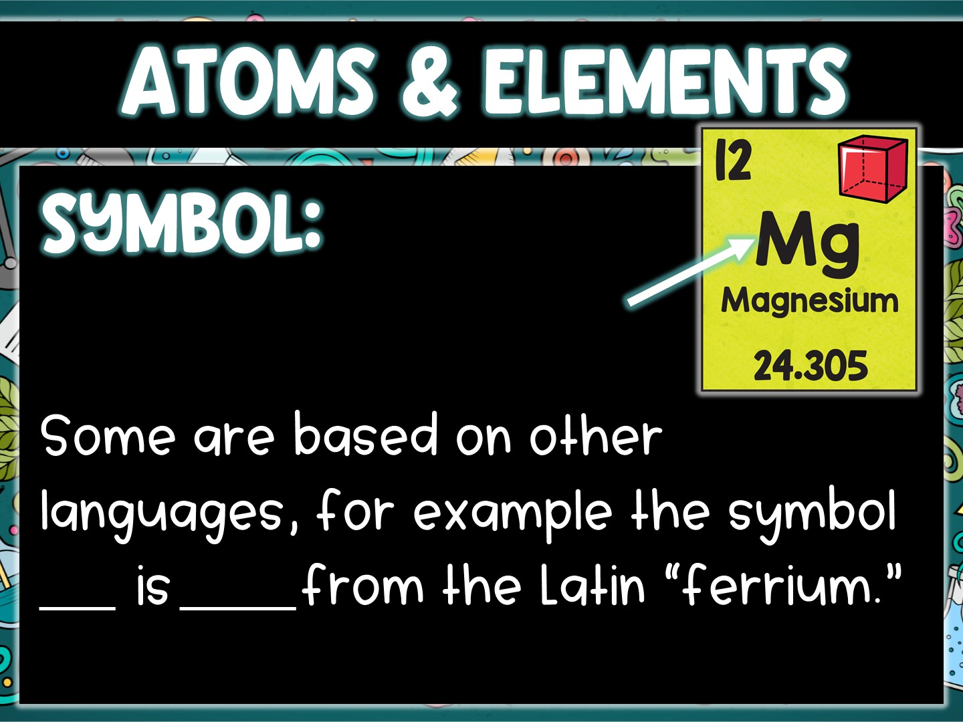
Fe
iron

Slide 18
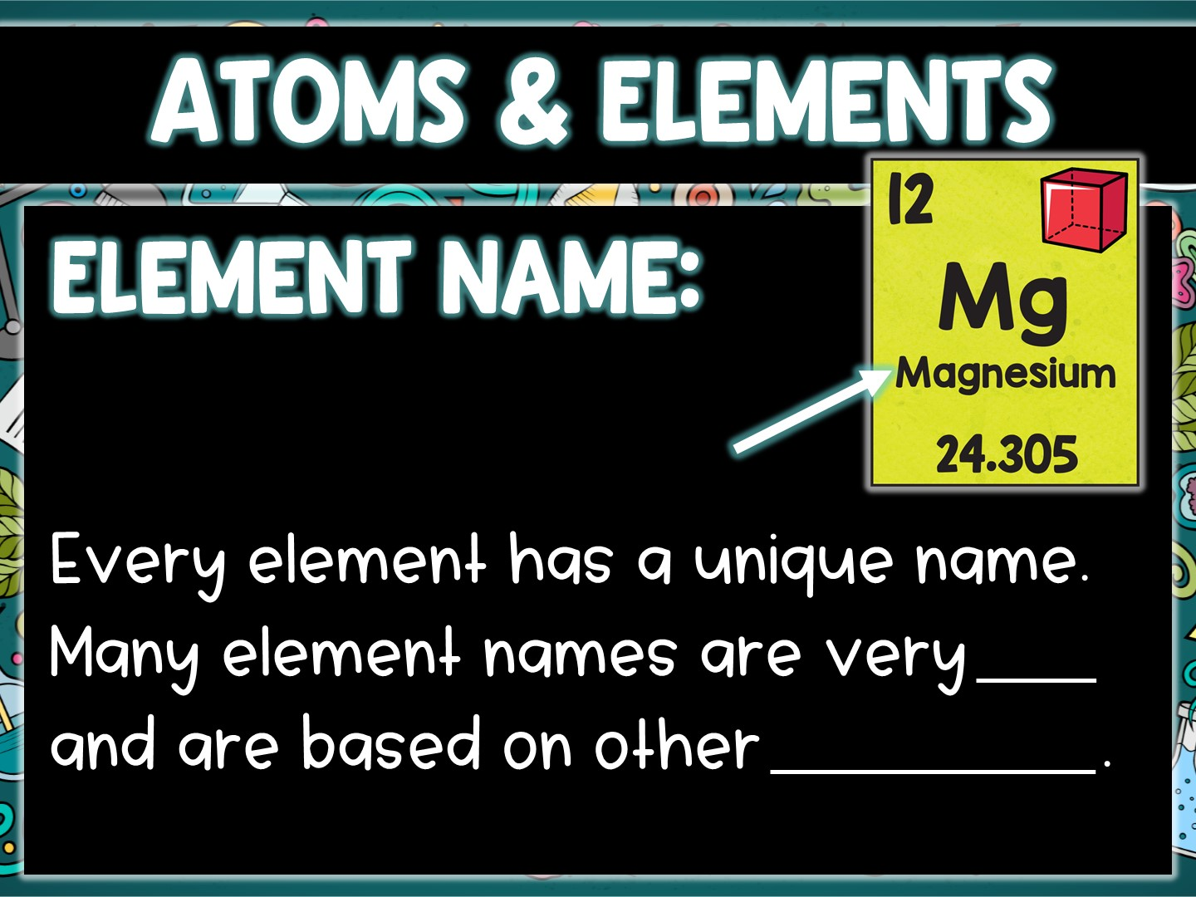
old
languages

Slide 19
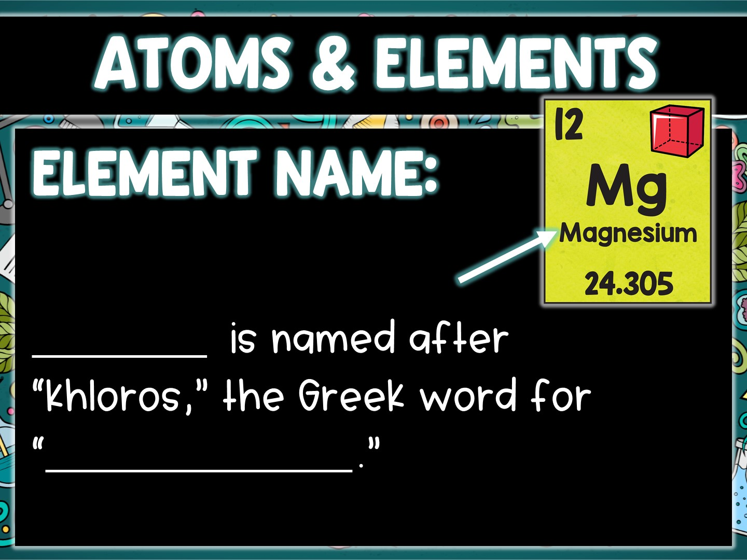
Chlorine
yellowish green

Slide 20
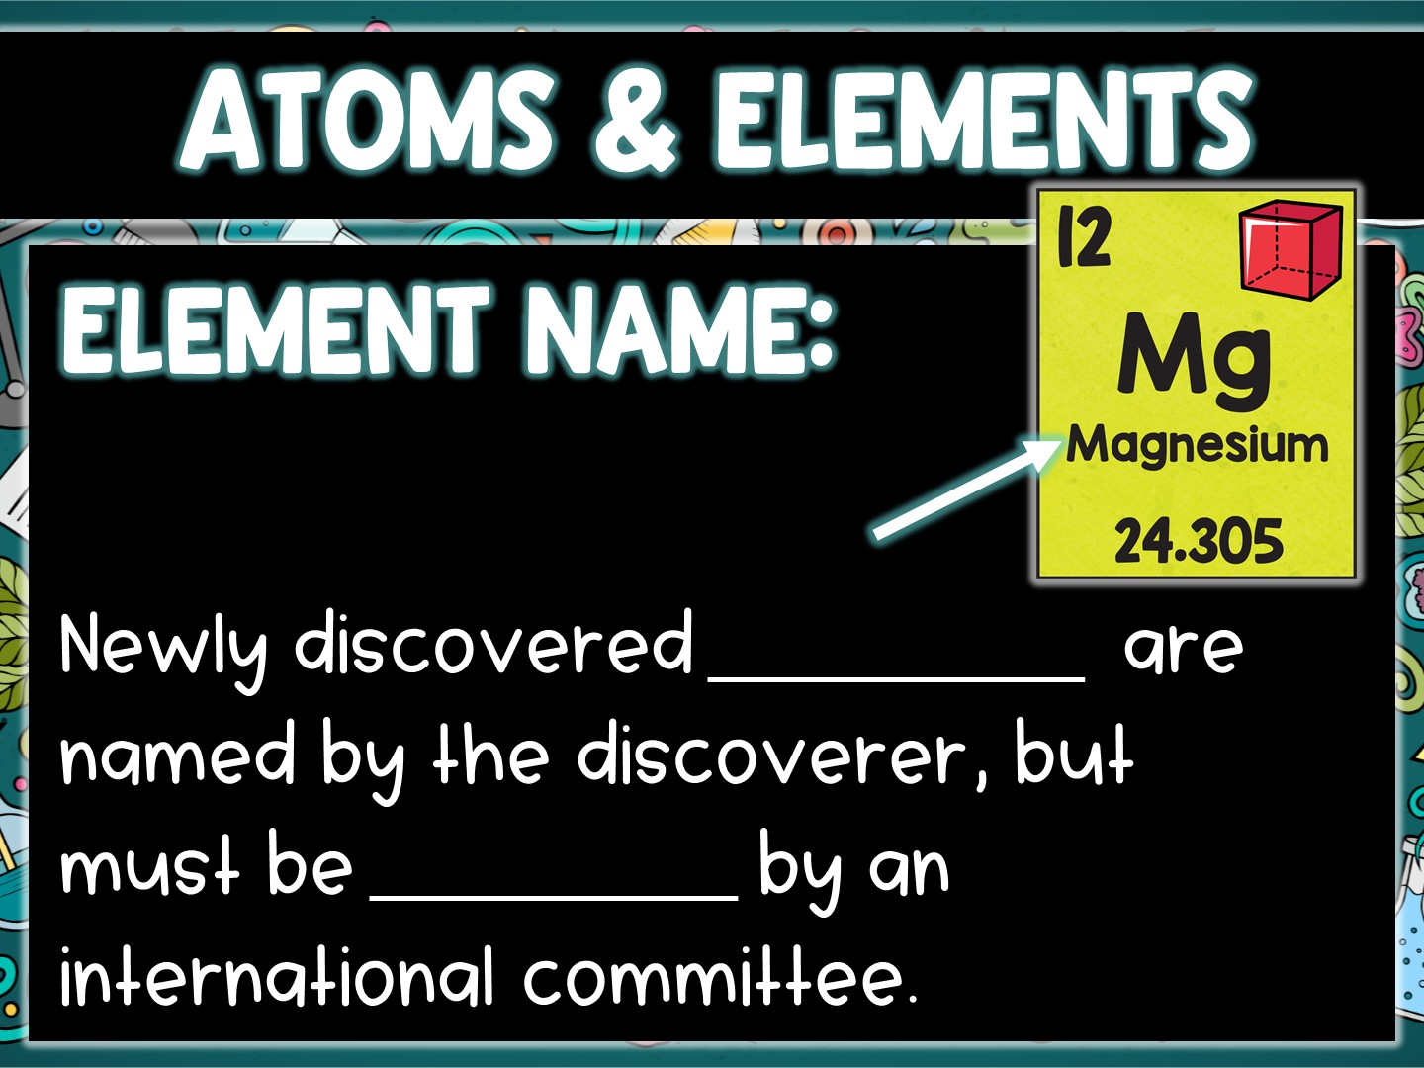
elements
approved

Slide 21
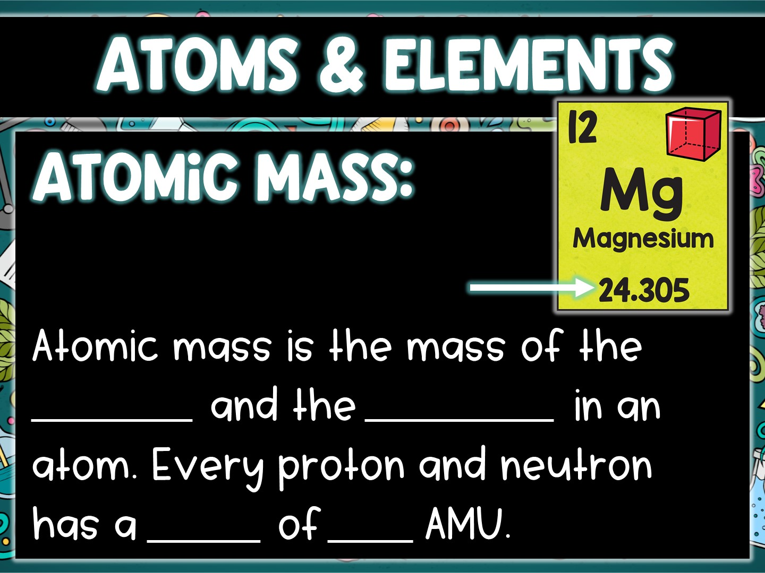
protons
neutrons
mass
one

Slide 22
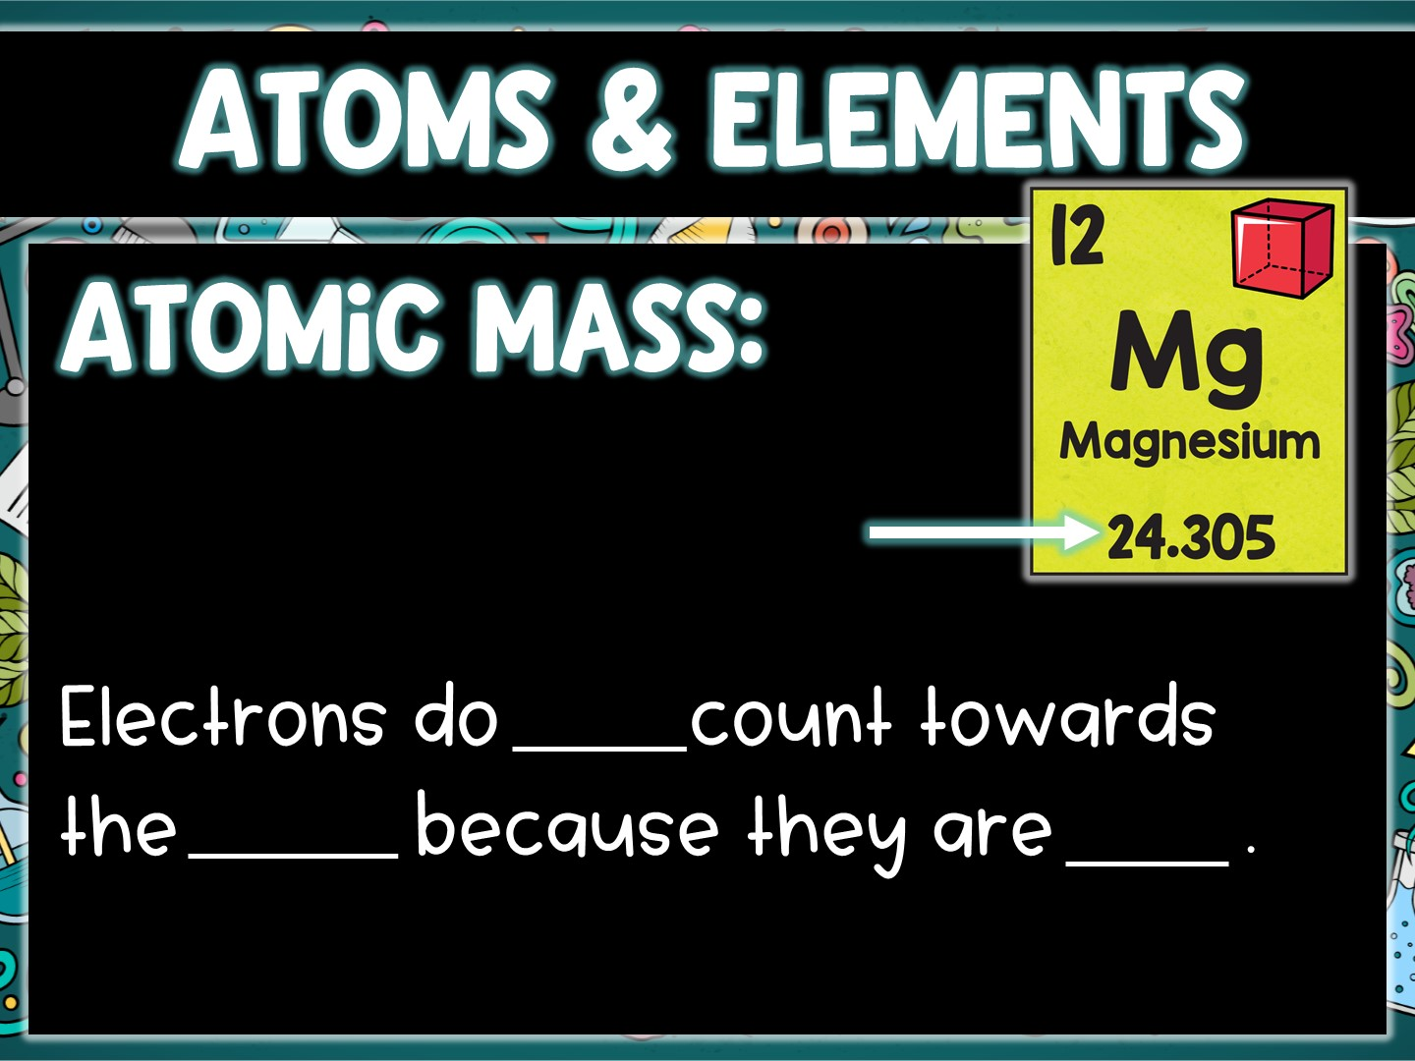
NOT
mass
tiny

Slide 23
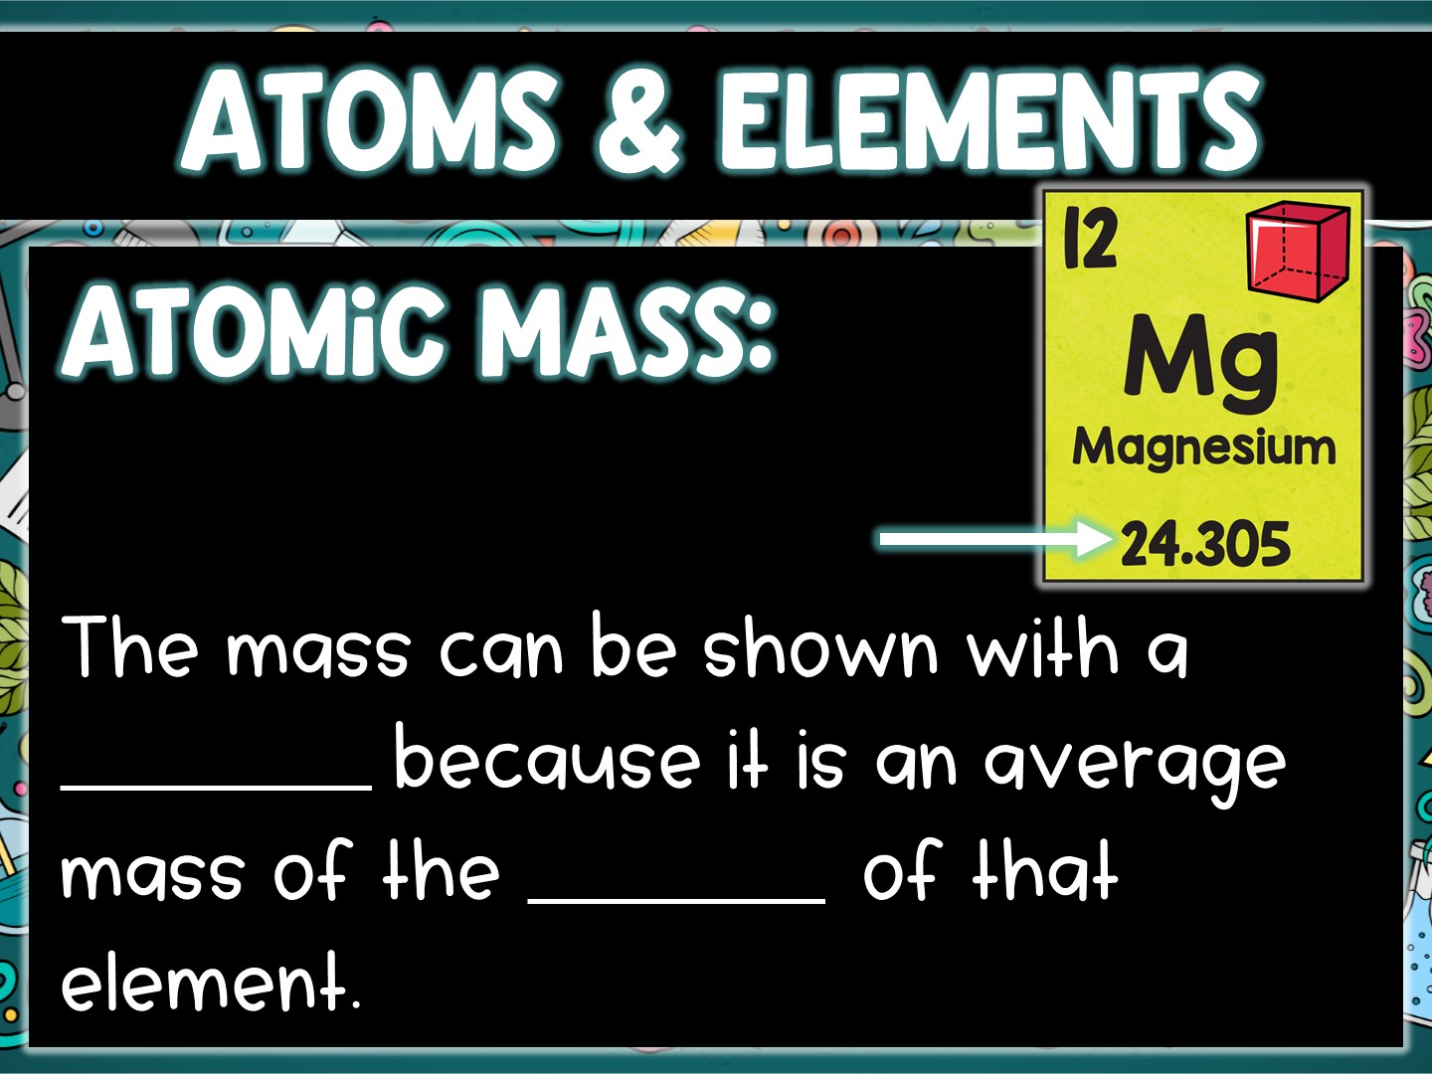
decimal
isotopes

